Slide 1
Engineering Ethics
A General Approach
Computer Engineering as a Discipline

Slide 2
Definitions
Engineering Ethics

Slide 3
What is Ethics (Oxford Dictionary)
Moral Principles that govern a persons behavior in conducting activity.
Branch of Knowledge that deals with moral principles.

Slide 4
What are Moral Principles?
The principles that are accepted by an individual or a social group.

Slide 5
Issue of Stem Cell Research Moral Principles Dilemma
Roman Catholic Point of View
Any egg that has been fertilized and has divided in its earliest state is considered to have life and a soul. As such it must be treated with dignity and respect.
Mainstream Medical Research
Embryonic stem cells can be created by using fertilized eggs grown in a petri-dish for a period of four to five days.
Not implanted inside any woman kept alive in laboratory conditions.

Slide 6
Difference between Law and Morality
Moral Principles
The principles that are accepted by an individual or a social group.
Example:
Murder of another person is immoral
Law
A set of codified rules approved by men / women who are considered as representatives that codifies laws to administer the land and its people.
Example
Religious Cannon Law:
To murder the enemy in war is not a sin.
Civil Law:
To kill another person in self defense is not against the law but…..

Slide 7
Moral Principles
Should be:
Agreed Upon by individuals
Social Groups
Can be based on cultural influence
Tied to Religion
Tied to Tradition

Slide 8
Moral Principles and Engineering
Agree Upon means by:
Signing at Contract
Verbal Contract
Inherent Contract
Examples of Agreement
Accepting a License
Membership to an Organization
Association as a member of a regional / national.

Slide 9


Engineering Ethics
Obligations
Fundamental Canons
Moral Principles
Social Group

Slide 10
Fundamental Canon
Engineers, in the fulfillment of their professional duties, shall:
1. Hold paramount the safety, health and welfare of the public.
2. Perform services only in areas of their competence.
3. Issue public statements only in an objective and truthful manner.
4. Act for each employer or client as faithful agents or trustees.
5. Avoid deceptive acts.
6. Conduct themselves honorably, responsibly, ethically, and lawfully so as to enhance the honor, reputation and usefulness of the profession.

Slide 11
Obligations
Engineers shall be guided in all their relations by the highest standards of honesty and integrity.
Engineers shall at all times strive to serve the public interest.
Engineers shall avoid all conduct or practice that deceives the public.
Engineers shall not disclose, without consent, confidential information concerning the business affairs or technical processes of any present or former client or employer, or public body on which they serve.
Engineers shall not be influenced in their professional duties by conflicting interests.
Engineers shall not attempt to obtain employment or advancement or professional engagements by untruthfully criticizing other engineers, or by other improper or questionable methods.
Engineers shall not attempt to injure, maliciously or falsely, directly or indirectly, the professional reputation, prospects, practice, or employment of other engineers.
Engineers shall accept personal responsibility for their professional activities, provided, however, that engineers may seek indemnification for services arising out of their practice for other than gr Engineers shall give credit for engineering work to those to whom credit is due, and will recognize the proprietary interests of others.
Engineers shall give credit for engineering work to those to whom credit is due, and will recognize the proprietary interests of others.

Slide 12
Engineering Preamble (Engineering Fundamentals)
The service provided by an engineer require that he/she impart:
Honesty
Impartiality
Fairness
Equity
Dedication to the protection of the public health, safety and welfare.
Notes:
Engineering is an important and learned profession. As members of this profession, engineers are expected to exhibit the highest standards of honesty and integrity. Engineering has a direct and vital impact on the quality of life for all people. Accordingly, the services provided by engineers require honesty, impartiality, fairness and equity, and must be dedicated to the protection of the public health, safety and welfare. Engineers must perform under a standard of professional behavior which requires adherence to the highest principles of ethical conduct.

Slide 13
Example
Order of the Engineer
I am an Engineer. In my profession, I take deep pride. To it, I owe solemn obligations.
As an engineer, I pledge to practice integrity and fair dealing, tolerance and respect, and to uphold devotion to the standards and dignity of my profession. I will always be conscious that my skill carries with it the obligation to serve humanity by making the best use of the Earth's precious wealth.
As an engineer, I shall participate in none but honest enterprises. When needed, my skill and knowledge shall be given, without reservation, for the public good. In the performance of duty, and in fidelity to my profession, I shall give my utmost.
— "Obligation of an Engineer"^{[1][2]}

Slide 14
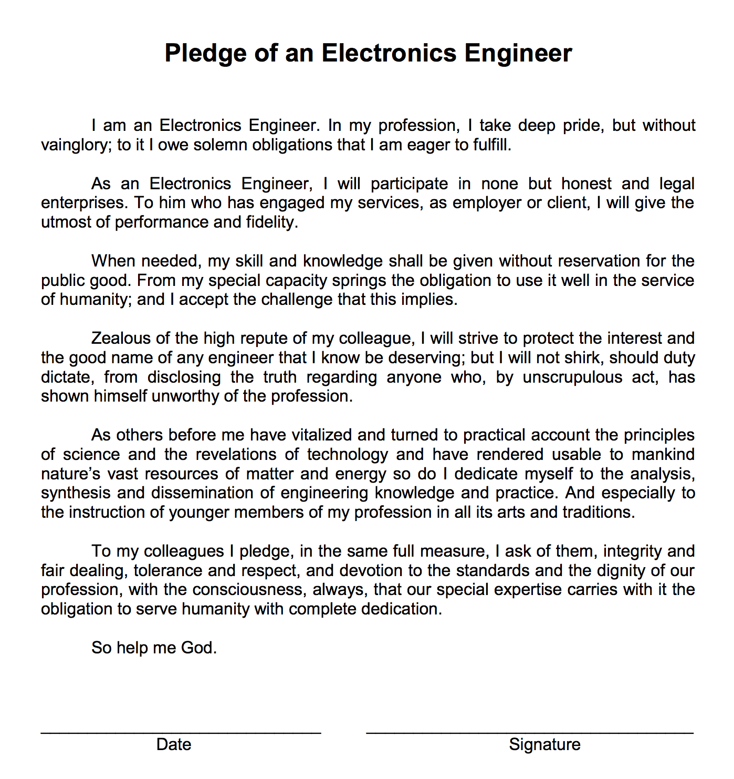
Example
Institute of Electronics and Communications Engineering

